Slide 1
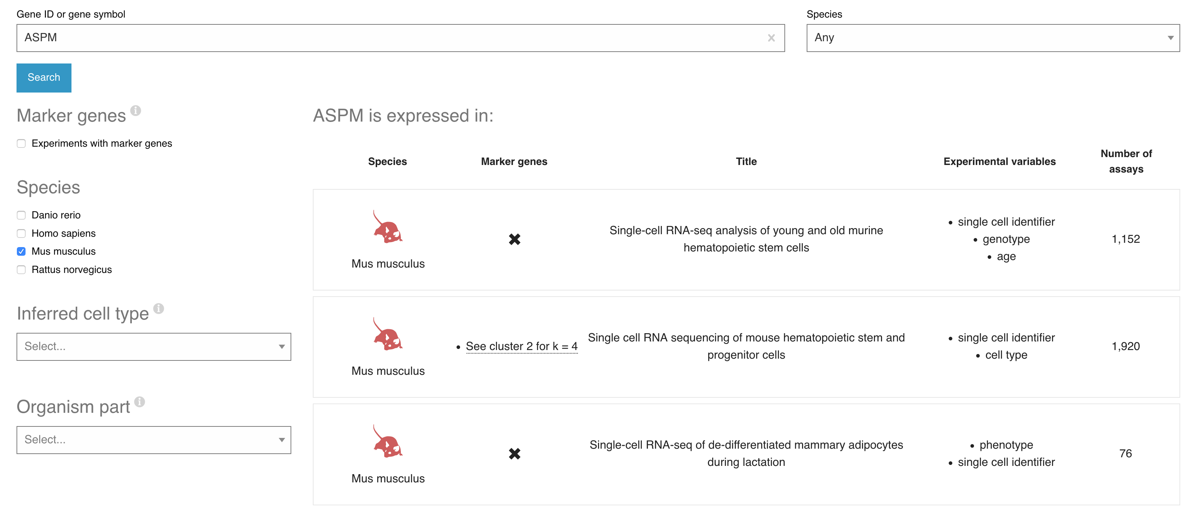
Use filters to narrow down your search results
Use filters to narrow down your search results

Slide 2
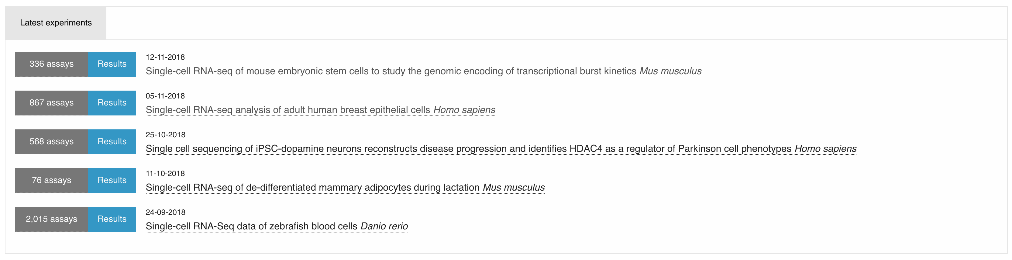

Slide 3
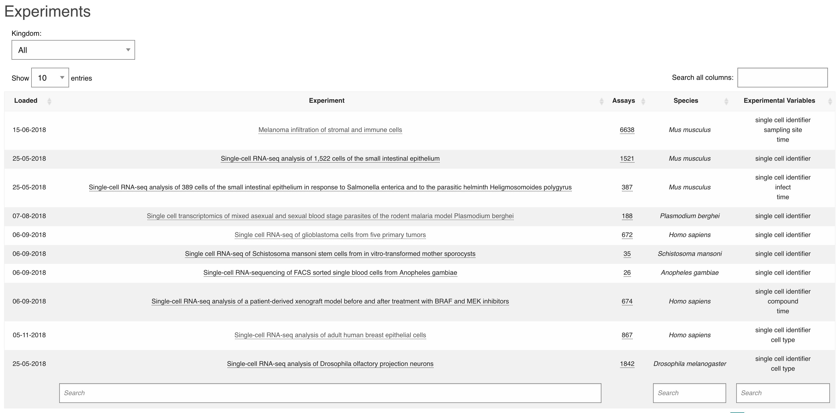
Refine organism search
Search in title
By species or experimental variable

Slide 4


Slide 6
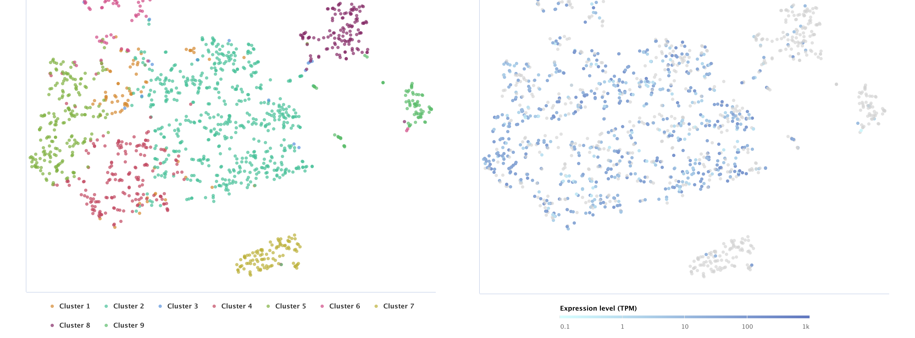
Set perplexity score
Cell colour scheme
Show expression of gene of interest per cell

Slide 7
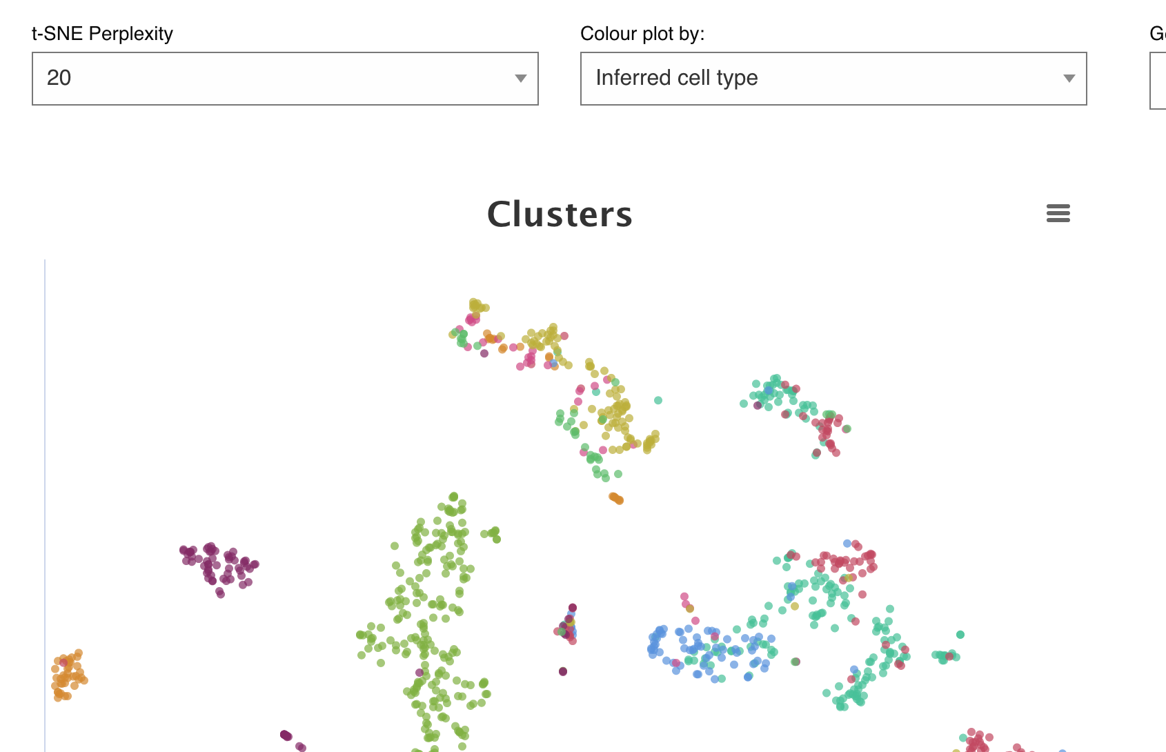
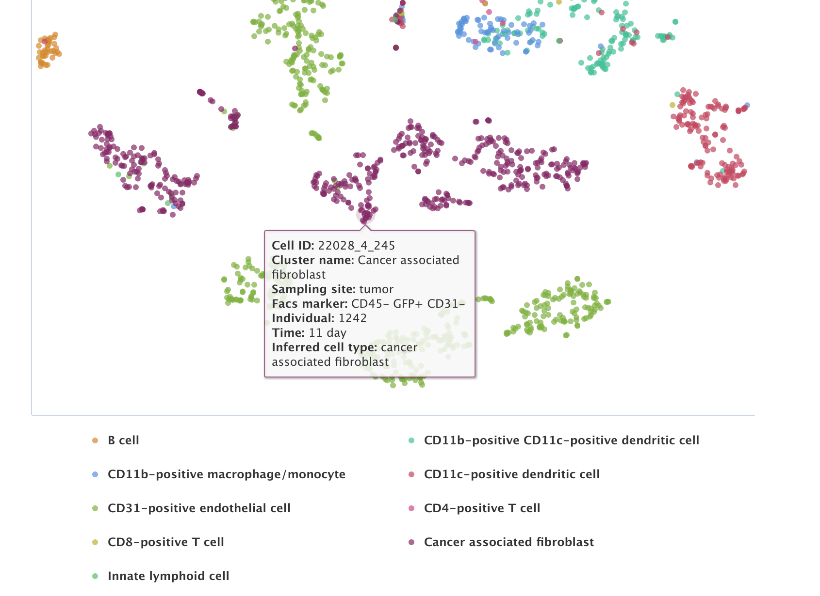

Slide 8
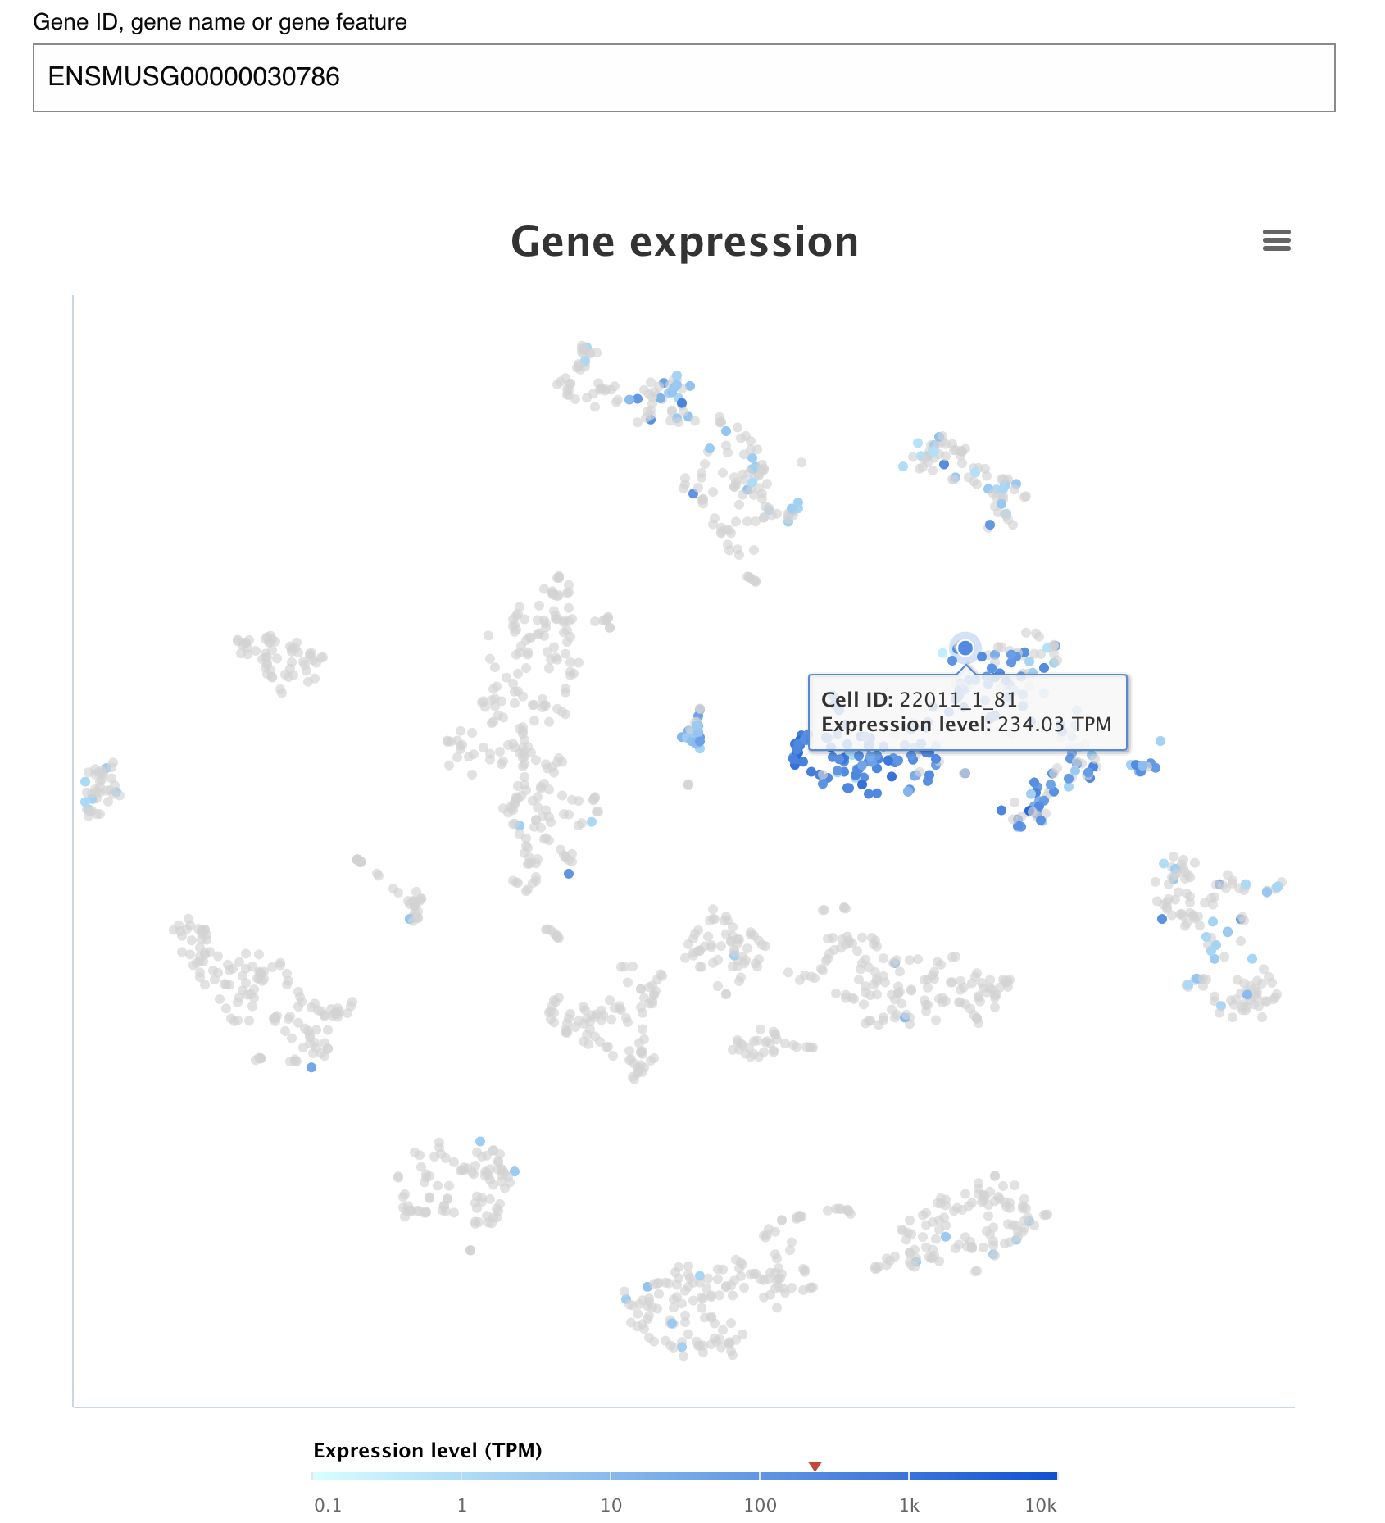
Select gene of interest to view expression levels
Range of highest and lowest values of expression levels in dataset for gene of interest

Slide 9
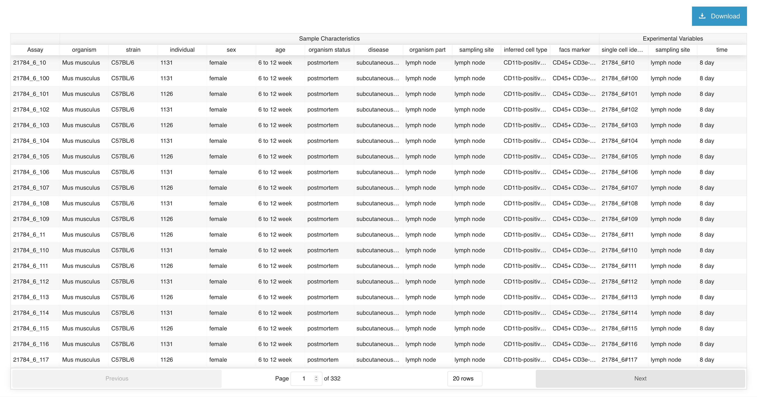
Sample metadata
Sort by clicking on the header
Experiment groups
Data traversal controls

Slide 10
